Slide 1
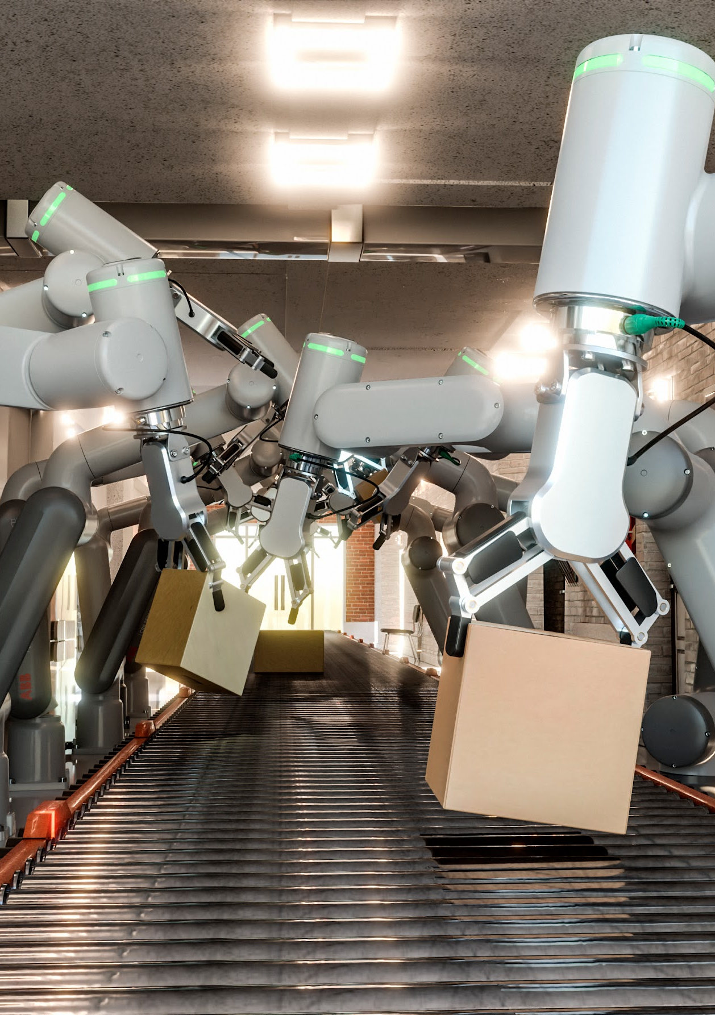
REVOLUTIONIZING FAULT DETECTION IN INDUSTRIAL ROBOTICS A CNN-LSTM BASED APPROACH FOR MOTOR DRIVE CONTROL SYSTEM
GUIDE NAME :
Mrs. SUNDARI G
Assistant Professor/CSE
BARATH P (510620104010)

Slide 2
ABSTRACT
This study addresses the enhancement of reliability and performance in industrial robots' motor drive control systems through the implementation of a fault detection mechanism.
Leveraging Convolutional Neural Networks (CNN) and Long Short-Term Memory (LSTM) networks, the proposed observers aim to swiftly identify and categorize faults, including sensor failures, thereby minimizing downtime and maintenance expenses.
The methodology involves real-time performance monitoring, adaptive control strategies, and seamless integration into the existing control system. The effectiveness of the approach is validated through extensive simulations and experiments. The successful implementation of CNN-LSTM-based observers promises to bolster the resilience of industrial robot systems, offering a robust solution for proactive fault detection while preserving overall operational efficiency.

Slide 3
LITERATURE SURVEY
S.NO | YEAR | TITLE | DESCRIPTION | DISADVANTAGES
1 | 2017 | Adaptive Model Verification for Modularized Industry 4.0 Applications | The abstract introduces a novel verification framework for modular Cyber-Physical Systems (CPSs) in Industry 4.0 applications, addressing the challenge of uncertainty in sensor networks. | High error-susceptibility
2 | 2017 | A Multimodal Anomaly Detector for Robot-Assisted Feeding Using an LSTM-based Variational Autoencoder | The approach utilizing a long short-term memory-based variational auto encoder (LSTM-VAE) for fusing multimodal sensory signals to detect anomalous executions in assistive manipulation tasks | May require significant computational resources
3 | 2018 | Diagnosis of operational malfunctions and failures by the fmea method in the industrial robots sector | This presents novel application of Failure Modes and Effects Analysis (FMEA) to assess risks in institutional client order fulfillment within the industrial robots sector, emphasizing a systematic evaluation of failures' importance, risk, and detectability. | Incomplete risk assessment for clients.

Slide 4
4 | 2018 | An Ensemble Oversampling Model for Class Imbalance Problem in Software Defect Prediction | The abstract highlights the challenge of class imbalance in fault detection models for software systems ,the importance of addressing this issue to prevent costly errors in real-world applications. | Inaccuracy of interpretation of data.
5 | 2019 | Fault Detection and State Estimation In Robotic Automatic Control Using Machine Learning | The system integrates various sensors like cameras, force sensors, and joint encoders to capture multimodal data (visual, force, and movement information) during feeding. | More challenging due to the complex nature of deep learning models.
6 | 2019 | An Unsupervised Reconstruction-Based Fault Detection Algorithm for Maritime Components | The paper proposes an unsupervised fault detection algorithm for ship systems, validated on real operational data, suitable for pure data-driven diagnostics in health management (PHM) systems. | The complexity of maritime systems or the volume of data increases.
7 | 2021 | Vision-Based Fault Action Detection for Industrial Robots | This paper method relies on analyzing video footage of the robot's operation to identify abnormal movements. | Computational cost: Real-time video analysis requiring powerful hardware.

Slide 5
8 | 2021 | Fault Diagnosis Method for Industrial Robots Based on DBN Joint Information Fusion Technology | The paper introduces a fault diagnosis method for industrial robots, leveraging DBN joint information fusion technology, achieving a accuracy in testing , suitable for diagnosing multiple faults in joint bearings. | Implementing DBN joint information fusion technology can be complex.
9 | 2023 | Retracted: Robot Fault Detection Based on Big Data | The author introduces a robot electrical fault detection and diagnosis, showing higher accuracy rates compared to other expert system based methods. | Data is not properly cleaned or pre-processed.
10 | 2023 | Anomaly Detection Using Ensemble Classification and Evidence Theory | This study examines multi-class ensemble classification with cloud services, uncertainty quantification, and proposing an anomaly detection method using evidence theory. | More space required.

Slide 6
EXISTING SYSTEM
The current motor drive control systems in industrial robots utilize traditional algorithms like Proportional-Integral-Derivative(PID) controllers and basic fault detection methods with manual intervention.
These approaches have limitations in real-time fault identification and are time-consuming.
This research proposes the integration of CNN-LSTM-based observers to enhance adaptability and responsiveness, overcoming manual detection shortcomings. The advanced machine learning techniques aim to automate fault detection, ensuring improved reliability in industrial robot systems.
Drawbacks:
Reactive Maintenance
Manual Inspection Challenges
Limited Data Utilization
Inefficiencies and Downtime

Slide 7
PROPOSED SYSTEM
The proposed system revolutionizes fault detection in motor drive control systems for industrial robots. By employing advanced Convolutional Neural Networks (CNN), Long Short-Term Memory (LSTM) networks and Boosting Algorithm, the system achieves real-time fault identification without manual intervention.
This adaptive approach, learning from historical data, enhances efficiency, reliability, and reduces downtime and maintenance costs.
The integration of CNN-LSTM-based observers represents a significant advancement, offering autonomous and proactive fault detection capabilities, surpassing the limitations of existing manual and algorithmic methods.
Advantages:
Proactive Fault Detection
Predictive Maintenance
Cost Reduction
Enhanced Productivity

Slide 8
SYSTEM ARCHITECTURE
Data Acquisition
Data preprocessing
Feature Extraction
Machine Learning Algorithms
Deployment
Model Evaluation
And Validation
Predictive Model Development

Slide 9
DOMAIN SPECIFICATION
Machine Learning :
Machine Learning is a system that can learn from example through self-improvement and without being explicitly coded by programmer. The breakthrough comes with the idea that a machine can singularly learn from the data (i.e., example) to produce accurate results.
Machine learning combines data with statistical tools to predict an output. This output is then used by corporate to makes actionable insights. Machine learning is closely related to data mining and Bayesian predictive modeling. The machine receives data as input, use an algorithm to formulate answers.

Slide 10
3.) Typical machine learning tasks are to provide a recommendation. For those who have a Netflix account, all recommendations of movies or series are based on the user's historical data. Tech companies are using unsupervised learning to improve the user experience with personalizing recommendation.
4.) Machine learning is also used for a variety of task like fraud detection, predictive maintenance, portfolio optimization, automatize task and so on.
Machine Learning vs. Traditional Programming
Traditional programming differs significantly from machine learning. In traditional programming, a programmer code all the rules in consultation with an expert in the industry for which software is being developed. Each rule is based on a logical foundation; the machine will execute an output following the logical statement. When the system grows complex, more rules need to be written. It can quickly become unsustainable to maintain.

Slide 11
MODULES
DATA COLLECTION
DATA PREPROCESSING
FEATURE EXTRACTION
MODEL SELECTION
EVALUATION MODEL
DEPLOY THE MODEL

Slide 12
MODULE 1 : DATA COLLECTION
This step is concerned with selecting the subset of all available data that you will be working with. Machine Learning problems start with data preferably, lots of data (examples or observations) for which you already know the target answer. Data for which you already know the target answer is called labeled data.

Slide 13
MODULE 2 : DATA PREPROCESSING
Formatting: The data you have selected may not be in a format that is suitable for you to work with. The data may be in a relational database and you would like it in a flat file, or the data may be in a proprietary file format and you would like it in a relational database or a text file.
Cleaning: Cleaning data is the removal or fixing of missing data. There may be data instances that are incomplete and do not carry the data you believe you need to address the problem. These instances may need to be removed. Additionally, there may be sensitive information in some of the attributes and these attributes may need to be anonymized or removed from the data entirely.
Sampling: There may be far more selected data available than you need to work with. More data can result in much longer running times for algorithms and larger computational and memory requirements. You can take a smaller representative sample of the selected data that may be much faster for exploring and prototyping solutions before considering the whole dataset.

Slide 14
MODULE 3 : FEATURE EXTRACTION
Feature extraction is an attribute reduction process. Unlike feature selection, which ranks the existing attributes according to their predictive significance, feature extraction actually transforms the attributes. The transformed attributes, or features, are linear combinations of the original attributes. Finally, our models are trained using Classifier algorithm. We use classify module on Natural Language Toolkit library on Python. We use the labelled dataset gathered. The rest of our labelled data will be used to evaluate the models.

Slide 15
MODULE 4 : MODEL SELECTION
Choosing appropriate machine learning models, such as Boosting algorithms, to build the predictive model.
ALGORITHMS:
1. Adaboost - Adaptive Boosting is a very popular boosting technique that aims at combining multiple weak classifiers to build one strong classifier.
2. Catboost - CatBoost is more interpretable than other machine learning models. The library provides several tools for model interpretation, including feature importance and decision plots.

Slide 16
MODULE 5 : MODEL EVALUATION
Model Evaluation is an integral part of the model development process. It helps to find the best model that represents our data and how well the chosen model will work in the future. Evaluating model performance with the data used for training is not acceptable in data science because it can easily generate overoptimistic and over fitted models.

Slide 17
MODULE 6 : DEPLOY THE MODEL
Implementing the trained model into a usable system or application that can provide real-time predictions or insights to educators and stakeholders. This deployment phase ensures that the predictive model is accessible and usable in practical educational settings.

Slide 18
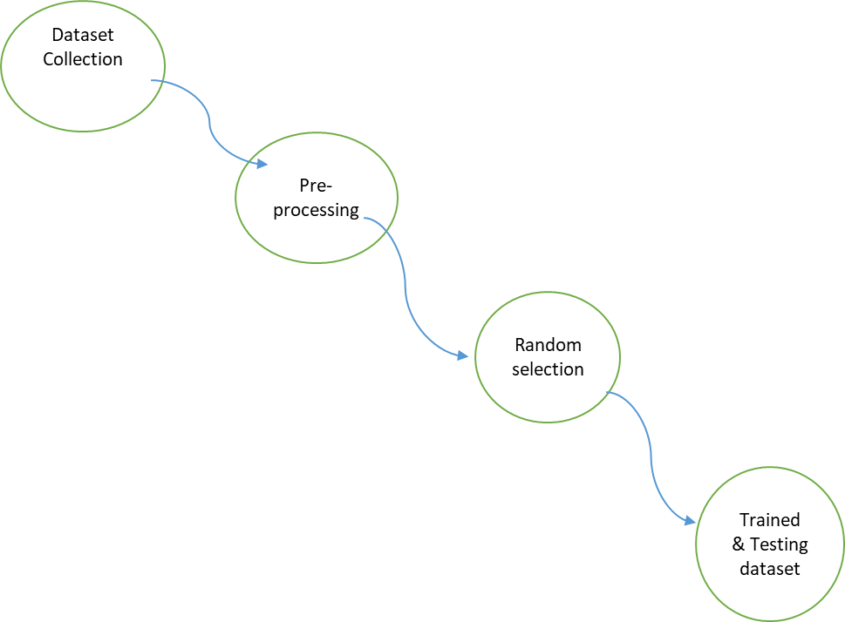
DATA FLOW DIAGRAM :
Level 0 :

Slide 19
Level 1 :
Dataset collection
Pre-processing
Feature Extraction

Slide 20
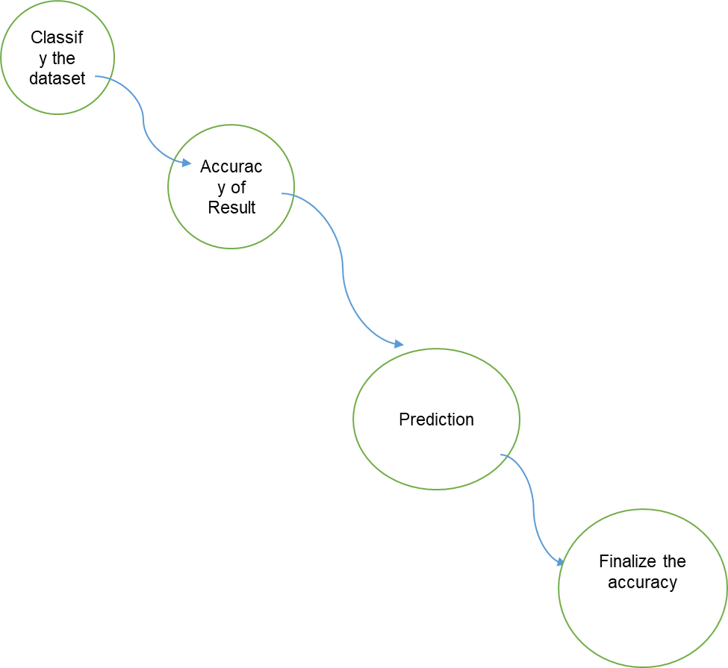
Level 2 :

Slide 21
UML DIAGRAMS:
USE CASE DIAGRAM
CLASS DIAGRAM
SEQUENCE DIAGRAM
ACTIVITY DIAGRAM
COLLABORATION DIAGRAM

Slide 22
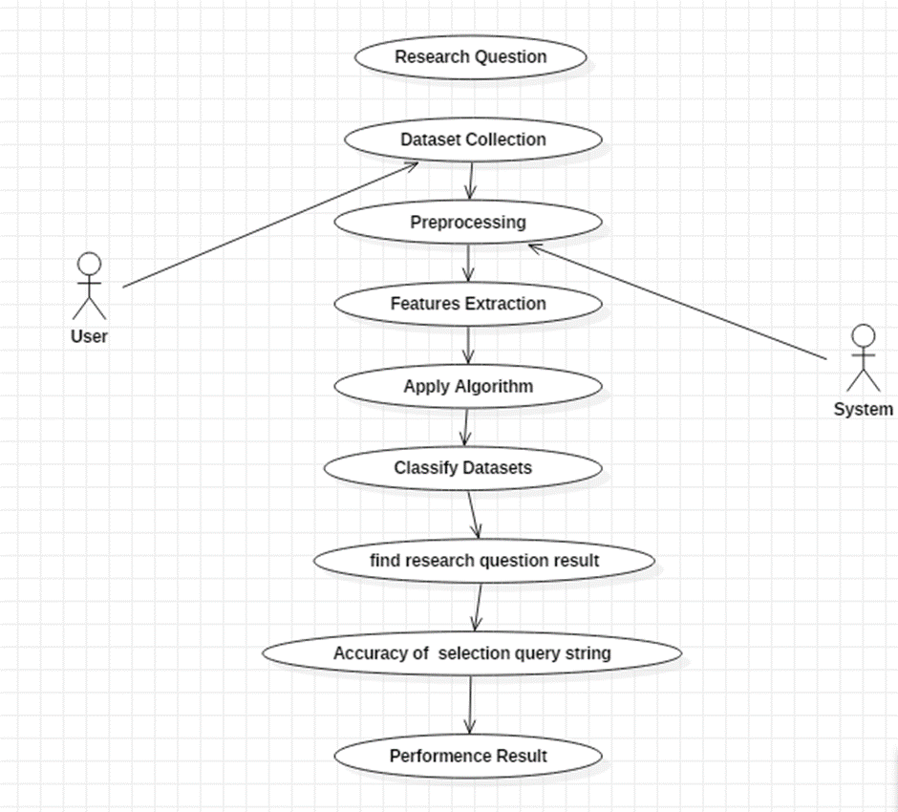
USE CASE DIAGRAM

Slide 23
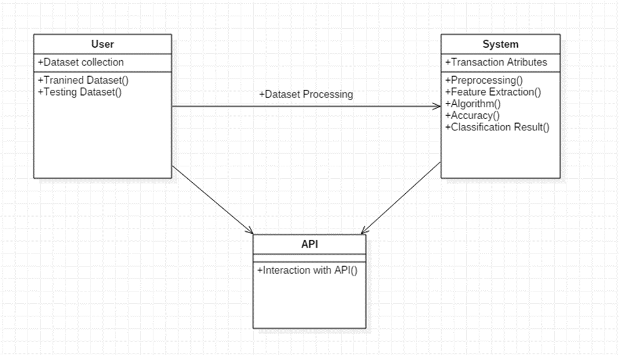
CLASS DIAGRAM

Slide 24
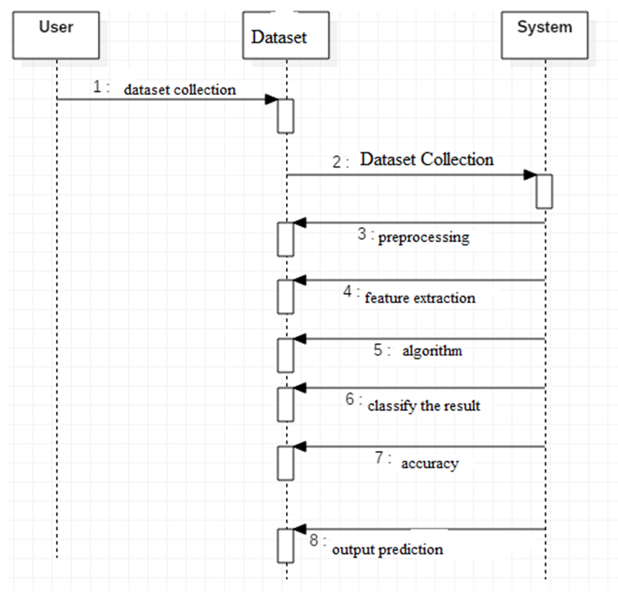
SEQUENCE DIAGRAM

Slide 25
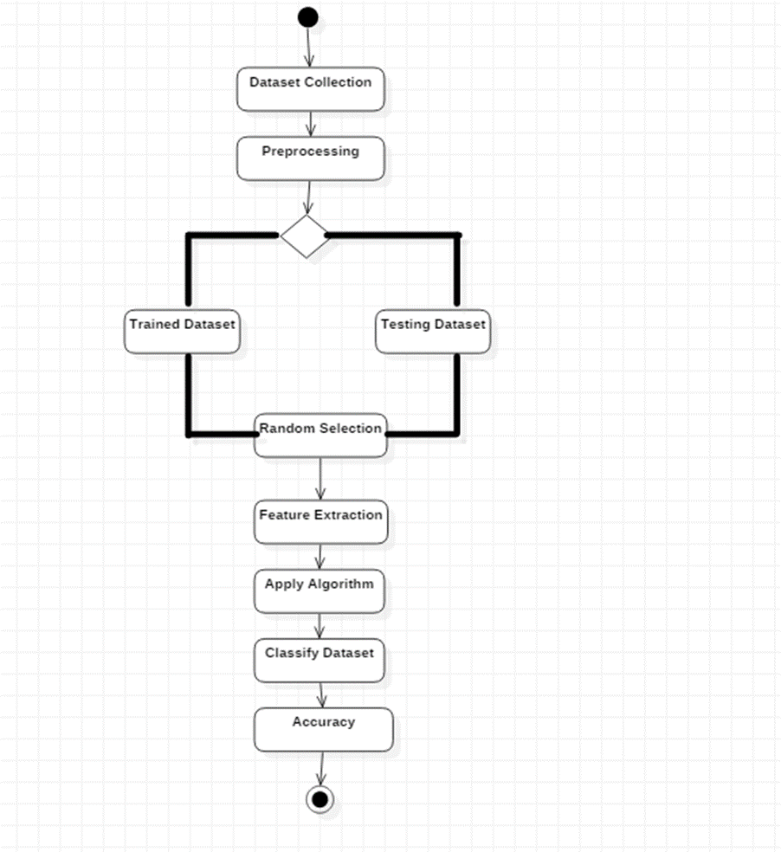
ACTIVITY DIAGRAM

Slide 26
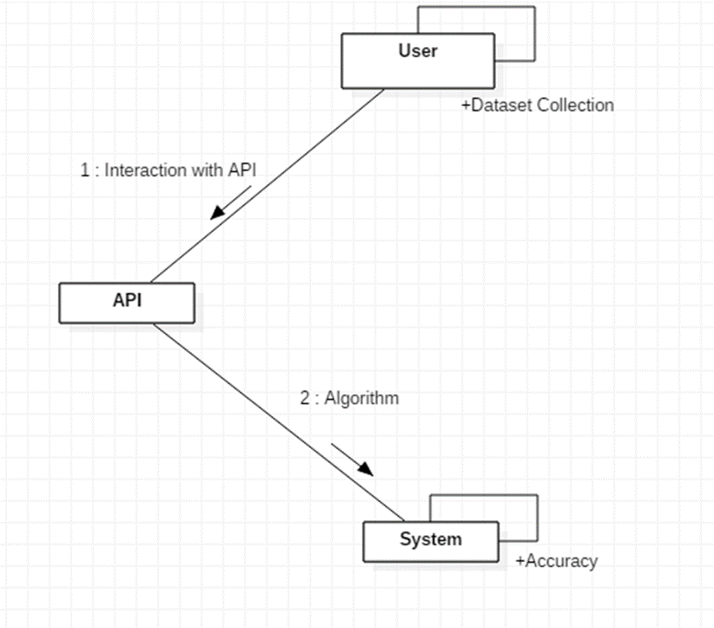
COLLABORATION DIAGRAM

Slide 27
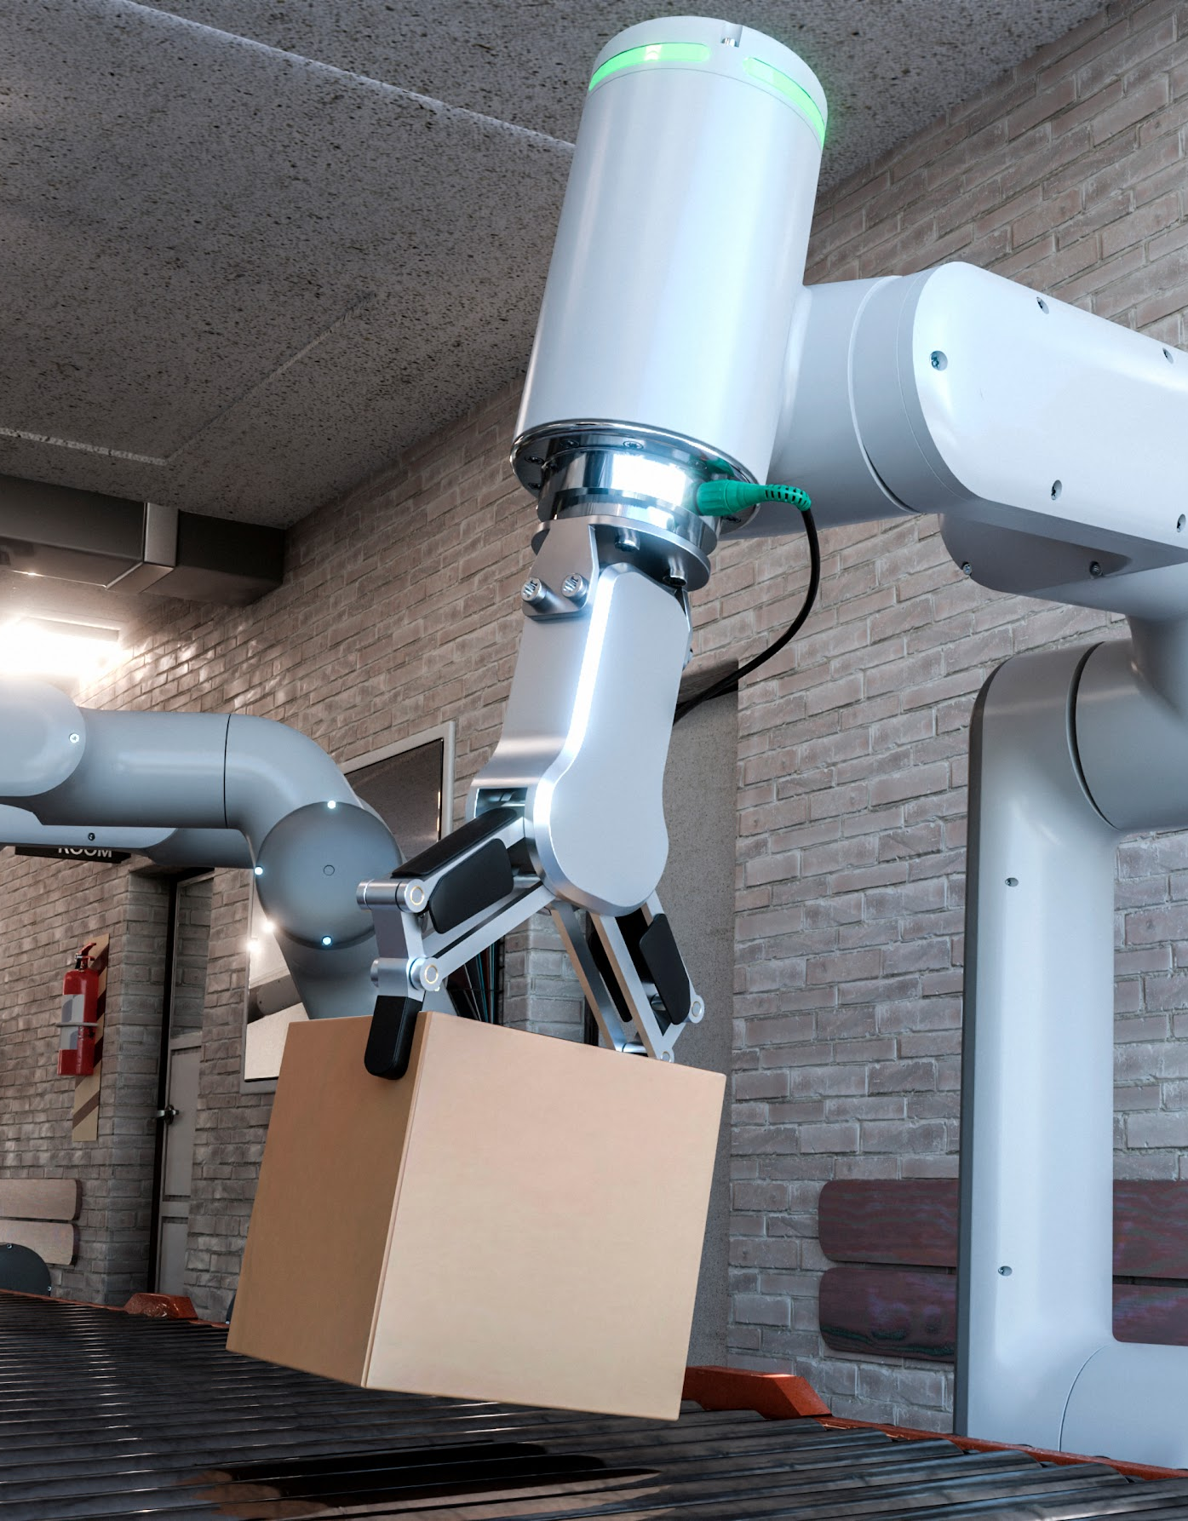
THANK YOU!

